Slide 1
Skill Analysis for Jobs
at Facebook
Nursultan Baitlessov
Sandip Sonawane

Slide 2

Introduction
Research Questions
Keeping yourself updated with the right skills is important
According to world economic forum, 50% of all employees will need to upskill in order to be relevant in their current position
1
2
3
What are the top skills required for different job categories?
How different job categories are related to each other and what are the shared skills?
If someone wants to switch to a different career journey, which one would be easier to switch?

Slide 3
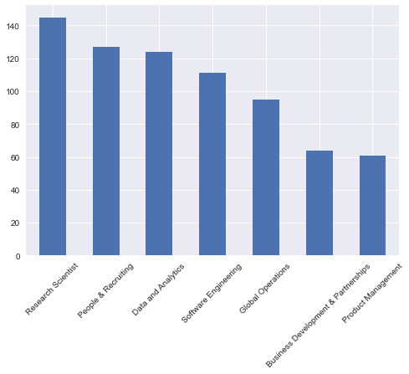
Dataset Research
727 Unique Facebook Job Postings
9 Attributes ['category', 'company', 'title', 'description', 'basic_qualifications', 'preferred_qualifications', 'country', 'state', 'qualifications', 'information']
7 Job Categories ['Product Management', 'Research Scientist', 'Data and Analytics', 'Business Development & Partnerships', 'Software Engineering', 'People & Recruiting', 'Global Operations']
No Missing Values

Slide 4
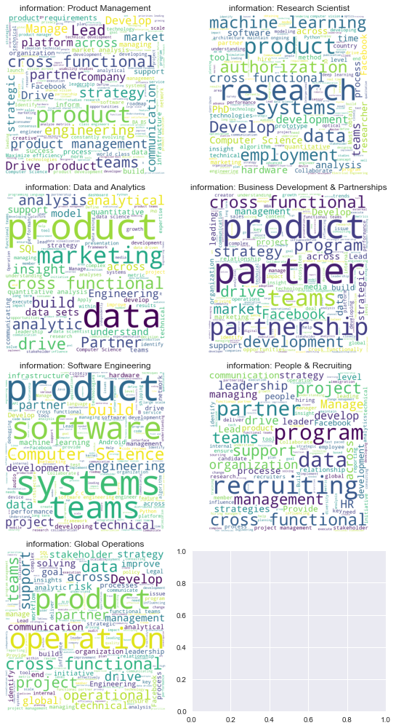
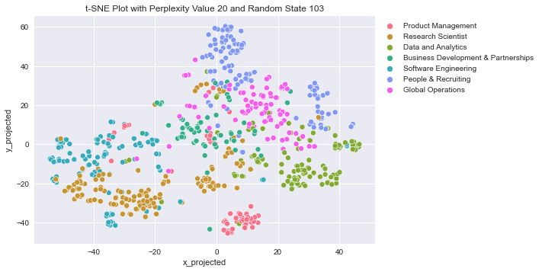
Exploratory Data Analysis

Slide 5
HAC Algorithm Selection motivation
Based on t-SNE plot, we can see for the same job category, there are small clusters at different proximity. Hence, this suggests that a hierarchical clustering algorithm may be able to identify such levels. Also it will help to learn the similarity between the job categories and to find their sub-clusters.

Slide 6
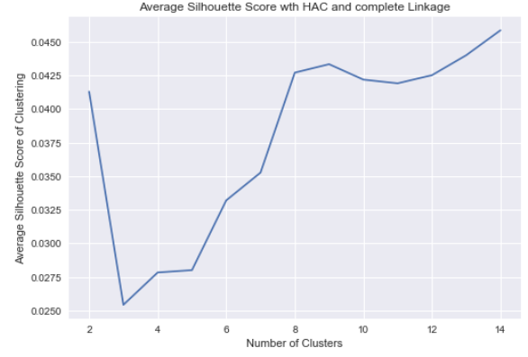
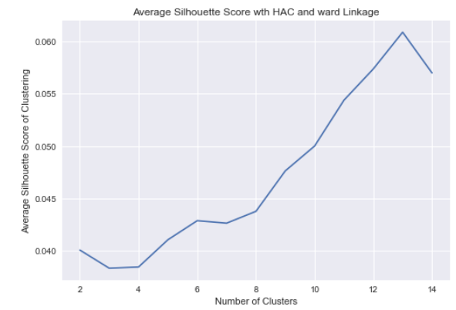
Algo. 1: Hierarchical Clustering Parameters Selection
Based on our data, the HAC with complete linkage is the best, because:
Even if it splits the main clusters apart, it is still able to identify the main clusters
It tends to work better with overlapping clusters
It is robust to noise that we have in our data

Slide 7
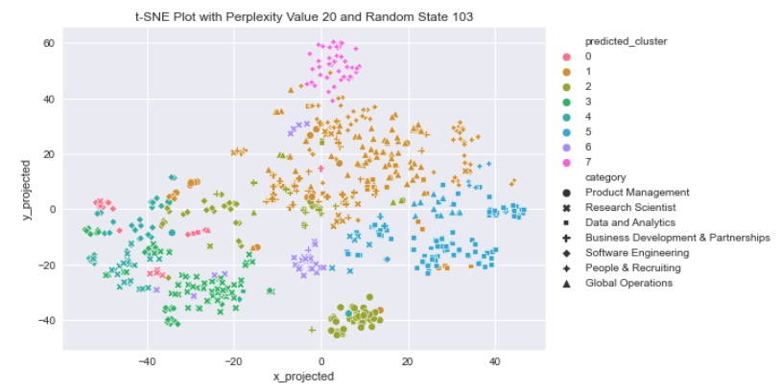
Algo. 1: Hierarchical Clustering Results 1
The main takeaways from this t-SNE plot:
Software Engineering job category has four sub-categories which were clustered to clusters 0, 2, 3 and 4.
Data and Analytics job category is different from the others
A lot of job postings are very similar among Business Development & Partnerships, People & Recruiting and Global Operations
Almost half of Product Management and People & Recruiting job openings are significantly different from the other job categories

Slide 8
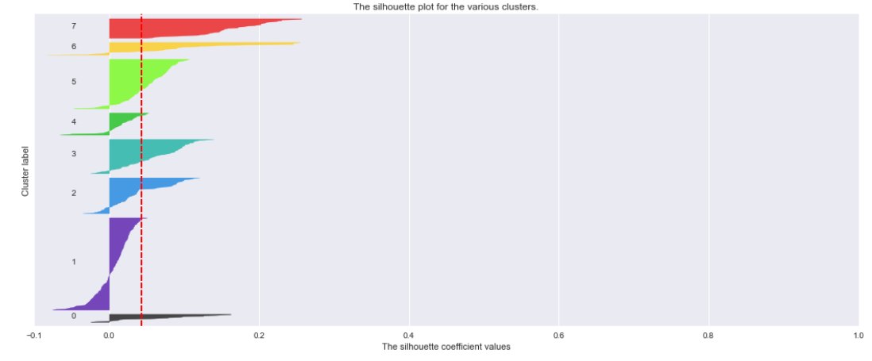
Algo. 1: Hierarchical Clustering Results 2

Slide 9
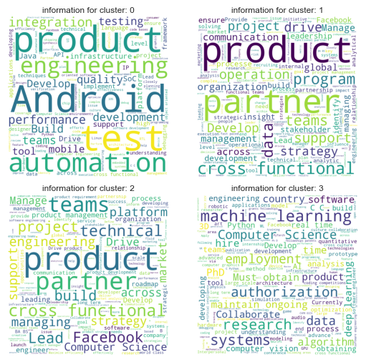
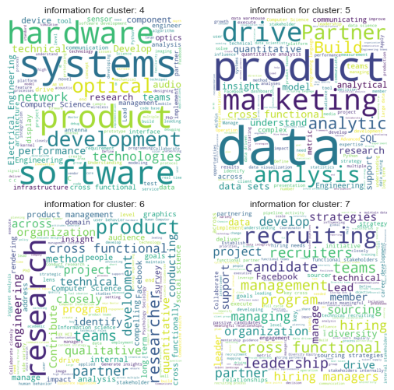
Algo. 1: Hierarchical Clustering Results 3

Slide 10
LDA Algorithm Selection motivation
We also want to understand which are the dominant words in each of the job category to understand the top skills that are required. This suggests that using Latent Dirichlet Algorithms (LDA) can be a good option.

Slide 11
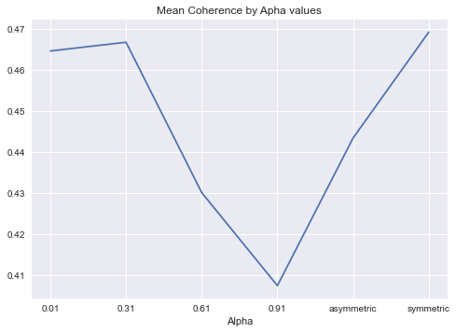
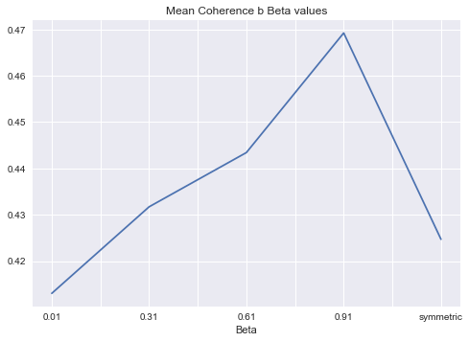
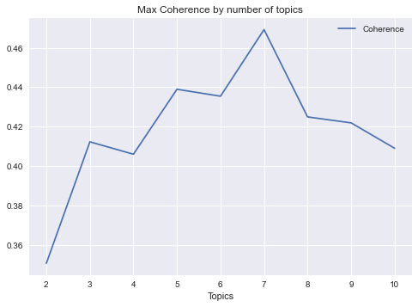
Algo 2: Latent Dirichlet Algorithm Parameters Selection
Topic Coherence scores a single topic based on the degree of semantic similarity between high scoring words in the topic. Semantic similarity is the task of determining how similar two words/ sentences are based on their meaning. A set of sentences or facts are said to be coherent, if they support each other. We will use topic coherence score to select alpha, beta parameters, and number of topics.

Slide 12
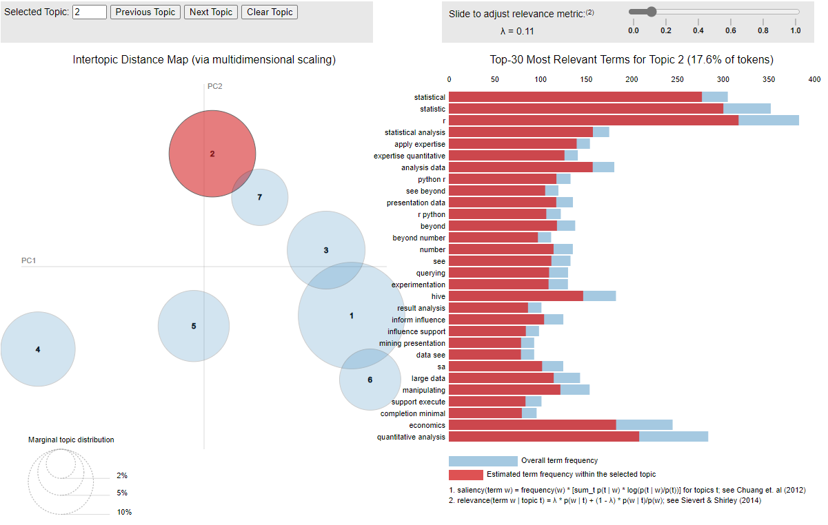
Algo 2: Latent Dirichlet Algorithm Results 1
1
What are the top skills required for different job categories?
3
If someone wants to switch to a different career journey, which one would be easier to switch?

Slide 13
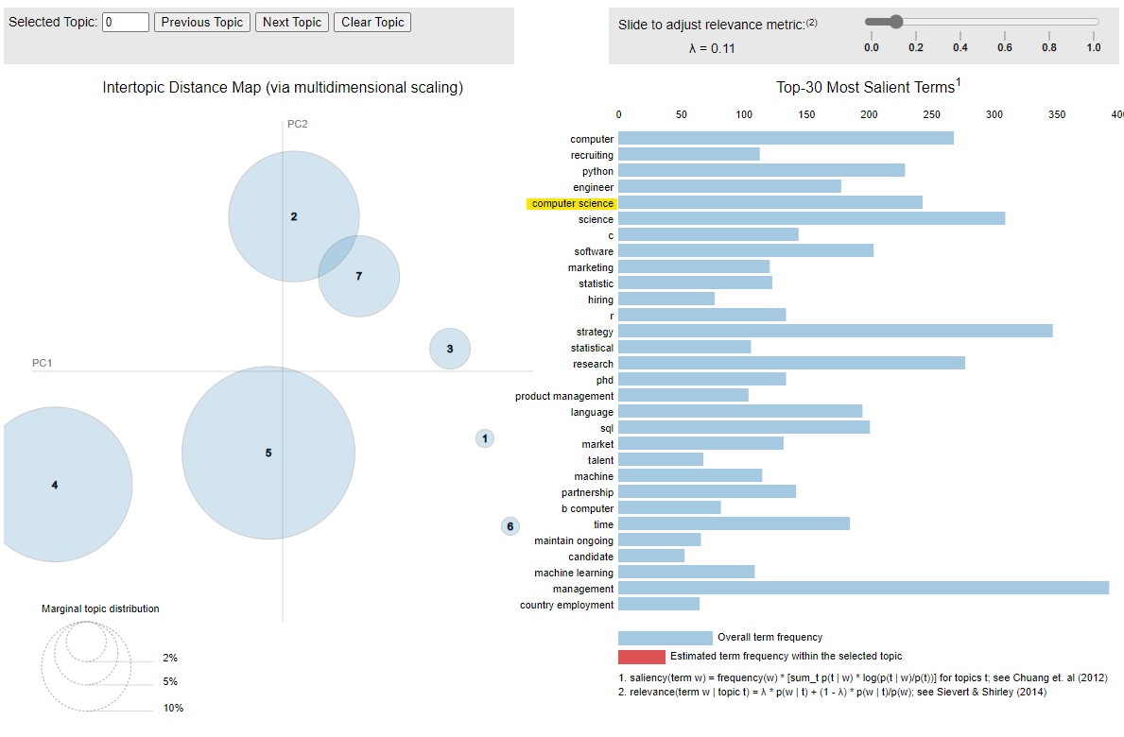
Algo 2: Latent Dirichlet Algorithm Results 2
2
How different job categories are related to each other and what are the shared skills?

Slide 14
Summary
Applied techniques learnt from STAT 430: Unsupervised Learning
Identified top skills required for different job categories
Identified shared skills among job categories and ease of switching to different role
Below are interesting findings.
Many of the job postings from Business Development & Partnerships, People & Recruiting and Global Operations job categories are very similar to each other and it may be easier to switch between these roles
A lot of the job postings are very similar between Software Engineering and Research Scientist roles. These job postings have sub-categories which are probably better described by the following roles: Machine Learning Engineer, Mobile Application Developer and Software Developer.
Data and analytics prefer R, Python, knowledge of statistics, distributing computing. Research scientists require knowledge of deep learning, pytorch, PhD, computer vision and have some patents. Software engineering requires knowledge of web, java, c, api, linux, networking, mobile, android, etc.

